Slide 1
Criticality-Aware Dynamic Task Scheduling for Heterogeneous Architectures
Kallia Chronaki, Alejandro Rico, Rosa M. Badia, Eduard Ayguadé, Jesus Labarta, Mateo Valero
Barcelona, June 2015

Slide 2
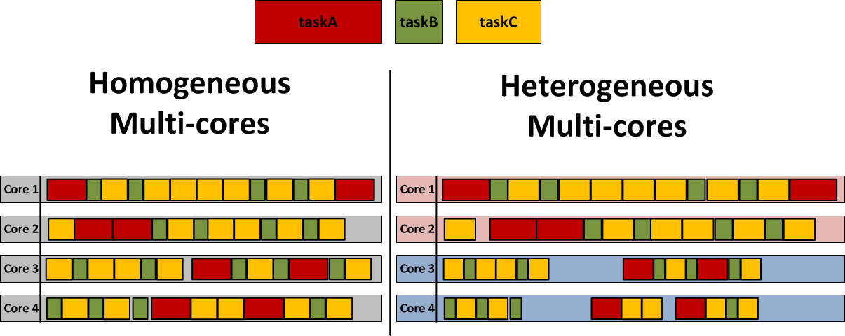
Moving from Homogeneous to Heterogeneous
time
time
Performance gaps!

Slide 3
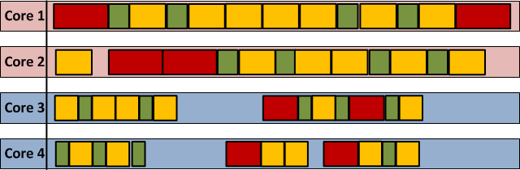
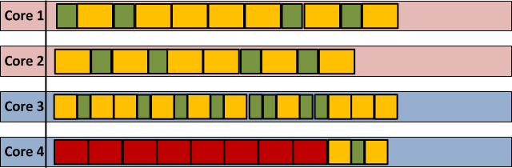
Scheduling is the solution
Scheduling!
Improvement

Slide 4
Overview
Background - OmpSs
Criticality-Aware Task Scheduler (CATS)
Task prioritization
Task submission
Task-to-processor assignment
Evaluation
Conclusions

Slide 5
OmpSs
Task-based programming model
User-defined dependencies between tasks
Dynamic scheduling and dependence analysis
Support for heterogeneous systems
Our target: ARM big.LITTLE
#pragma omp task in(x) out(y) void task1(int x, int y) { … } int main() { for(int i = 0; i <10; i++) for(int j = 0; j<10; j++) task1(i, j); return 0; }

Slide 6
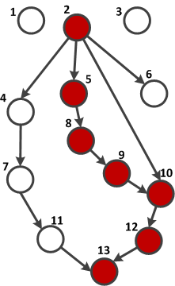
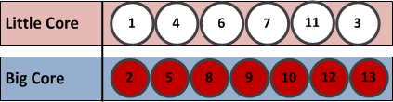
Criticality-Aware Task Scheduler (CATS)
Critical tasks:
The tasks that belong to the longest path of the task dependency graph (TDG)
Scheduling!

Slide 7
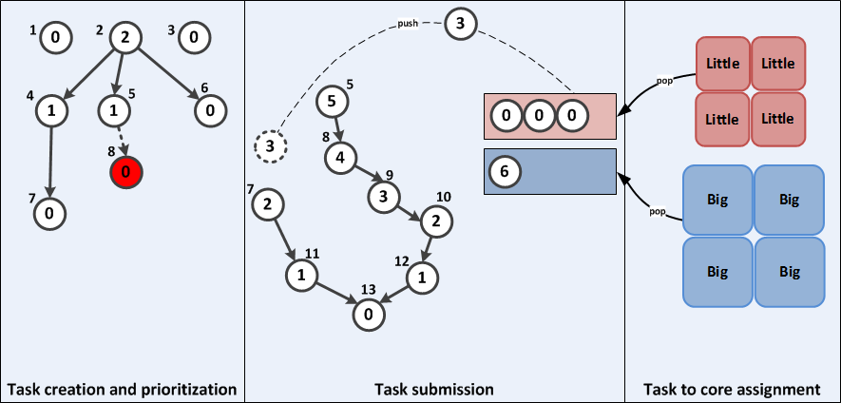
CATS Overview

Slide 8

Task Prioritization

Slide 9
Task Prioritization
Each task is prioritized by its bottom level
What is the bottom Level?
The number of edges in a longest path from a task to the bottom of the graph

Slide 10
Task Prioritization
1
2
3
Task id | Plist | priority
1 | { Ø } | 0
2 | { Ø } | 2
3 | { Ø } | 0
4 | { 2 } | 1
5 | { 2 } | 1
6 | { 2 } | 0
7 | { 4 } | 0
8 | { 5 } | 0
Task id | Plist | priority
1 | { Ø } | 0
2 | { Ø } | 2
3 | { Ø } | 0
4 | { 2 } | 1
5 | { 2 } | 0
6 | { 2 } | 0
7 | { 4 } | 0
8 | { 5 } | 0
Task id | Plist | priority
1 | { Ø } | 0
2 | { Ø } | 2
3 | { Ø } | 0
4 | { 2 } | 1
5 | { 2 } | 1
6 | { 2 } | 0
7 | { 4 } | 0
8 | { 5 } | 0
9 | { Ø } | 0
Task id | Plist | priority
1 | { Ø } | 0
2 | { Ø } | 2
3 | { Ø } | 0
4 | { 2 } | 1
5 | { 2 } | 1
6 | { 2 } | 0
7 | { 4 } | 0
8 | { 5 } | 0
9 | { 8 } | 0
Task id | Plist | priority
1 | { Ø } | 0
2 | { Ø } | 3
3 | { Ø } | 0
4 | { 2 } | 1
5 | { 2 } | 2
6 | { 2 } | 0
7 | { 4 } | 0
8 | { 5 } | 1
9 | { 8 } | 0
2
0
Task id | Plist | priority
1 | { Ø } | 0
2 | { Ø } | 2
3 | { Ø } | 0
4 | { 2 } | 1
5 | { 2 } | 0
6 | { 2 } | 0
7 | { 4 } | 0
8 | { Ø } | 0
0
3
4
1
5
6
0
0
1
2
8
7
1
0
9
0
0

Slide 11
Task Submission (ready time)

Slide 12
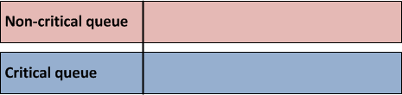
Task Submission (ready time)
1
2
3
maxPriority:
1
2
3
6
5
1
0
6
0
4
4
5
maxTaskSucc:
{ }
{ 4, 5, 6, 10 }
{ 8 }
{ 10 }
{ 12 }
{ 13 }
3
6
0
{ 9 }
5
8
7
4
2
9
3
10
11
2
1
1
12
13
0
Conditions
1. priorityOf(current) > maxPriority
2. priorityOf(current) == maxPriority-1 && current ∈ maxTaskSucc
☒
☑
☒
☑

Slide 13
Task Submission (ready time)
maxPriority:
1
2
3
6
5
Sorted queues according to the task priority
1
maxTaskSucc:
{ }
{ 4, 5, 6, 10 }
{ 8 }
{ 10 }
{ 12 }
{ 13 }
3
2
1
0
0
0
6
5
4
3
2
1
0
Conditions
1. priorityOf(current) > maxPriority
2. priorityOf(current) == maxPriority-1 && current ∈ maxTaskSucc
☒
☑

Slide 14
Flexibility and Strictness in Task Submission
maxPriority:
1
2
2
3
3
1
6
0
0
maxTaskSucc:
{ }
{ 4, 5, 6, 10 }
{ 8 }
{ 10 }
4
3
5
6
0
5
8
7
4
2
9
Two CATS configurations
Strict: priorityOf(4) > maxPriority
Flexible: priorityOf(4) >= maxPriority
Result: flexible results with more critical tasks
3
10
11
2
1
1
12
13
0

Slide 15
Task-to-Core Assignment

Slide 16
Task-to-Core Assignment
Little
Little
pop
Little
Little
3
2
1
0
0
0
6
5
4
3
2
1
0
work stealing
Big
Big
Optional: 2D work stealing
pop
Big
Big

Slide 17
Overview
Background - OmpSs
Criticality-Aware Task Scheduler (CATS)
Task prioritization
Task submission
Task-to-processor assignment
Evaluation
Conclusions

Slide 18
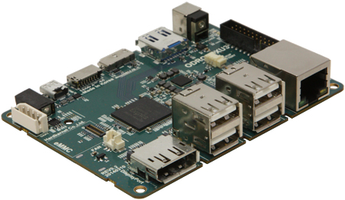
Platforms
ODROID XU3
8-core Samsung Exynos 5422
ARM big.LITTLE architecture
4 x Cortex-A15 cores at 2.0GHz (big)
4 x Cortex-A7 cores at 1.4GHz (little)
TaskSim
Larger systems (16 to 128 cores)
Different performance ratios of big and little (2× to 4×)

Slide 19
Evaluated Schedulers
Scheduler | Comments
CATS SS FLEX | Simple work stealing and flexible
CATS SS STRICT | Simple work stealing and strict
CATS 2DS FLEX | Bidirectional work stealing and flexible
CATS 2DS STRICT | Bidirectional work stealing and strict
BF | OmpSs default random FIFO scheduler
dHEFT | Dynamic implementation of HEFT [1] in OmpSs
[1] H. Topcuoglu et al. Performance-Effective and Low-Complexity Task Scheduling for Heterogeneous Computing

Slide 20
Benchmarks
Kernel | #Tasks | Measured Perf. Ratio | % Critical tasks
Cholesky 8x8 | 120 | 2.23 | 17.5
Cholesky 16x16 | 816 |  | 5.5
Integral Histogram | 2048 | 1.71 | 7.3
QR | 1496 | 4.26 | 4.4
Heat diffusion | 5124 | 2.83 | 4.1

Slide 21

Cholesky
Improvement up to 30%
SS FLEX configuration best
8x8
16x16
Improvement up to 9%
SS FLEX configuration best
Notes:
4 task types but small performance difference

Slide 22
Integral Histogram
Improvement up to 15%
SS FLEX is the winner!
A few exceptions for unbalanced systems (4little – 1big)
CATS improves according to critical tasks %
Kernel | #Tasks | Measured Perf. Ratio | % Critical tasks
Cholesky 8x8 | 120 | 2.23 | 17.5
Cholesky 16x16 | 816 |  | 5.5
Integral Histogram | 2048 | 1.71 | 7.3
Notes:
Dependency intensive application dHeft doesn’t take into account dependencies
Only 2 types of tasks

Slide 23
Double precision benchmarks: QR and Heat Diffusion
Improvement up to 20%
SS FLEX is the winner
Heat – higher improvement for balanced systems
QR
Heat
Kernel | #Tasks | Measured Perf. Ratio
QR | 1496 | 4.26
Heat diffusion | 5124 | 2.83
Notes:
QR: smaller critical tasks percentage, 4 task types
dHeft gets improvement in heat because of the private queues
2 cores get more improvement because of the less congestion in queues 1 queue per core PLUS the fact that %crit tasks is 50%

Slide 24
Simulation
Systems from 16 to 128 cores
1 to 64 big cores
Performance ratios (perf): 2, 2.5, 3, 3.5, 4
Big is perf times faster than little
Excluding integral histogram
No scaling beyond 16 cores
Excluding dHEFT
Currently no mechanism to track task execution time during simulation
Simulating the best CATS configuration, SS FLEX
80 systems in total

Slide 25
Simulation – Cholesky 32x32
Up to 40% improvement
Better results for systems with high performance ratio
Better results for balanced systems (#big == #little)
Few big cores create a hot spot

Slide 26
Simulation – QR and Heat diffusion
QR: up to 68% improvement
64big – 64little
Heat: up to 165% improvement
64big – 64little
QR
Heat

Slide 27
Conclusions
Better performance on heterogeneous multicores for free
CATS is implementable
No profiling
Runtime scheduling decisions
Evaluation on real benchmarks vs synthetic TDGs
Benefit for future heterogeneous multicores
Higher heterogeneity → higher performance improvement

Slide 28
For further information please contact
kallia.chronaki@bsc.es

Slide 29
Back ups
TDG of QR
TDG of Integral Histogram
dHEFT
BF
dHEFT profiling
Ideal speedup

Slide 30
TDG of QR
Back

Slide 31
TDG of Integral Histogram
Back

Slide 32
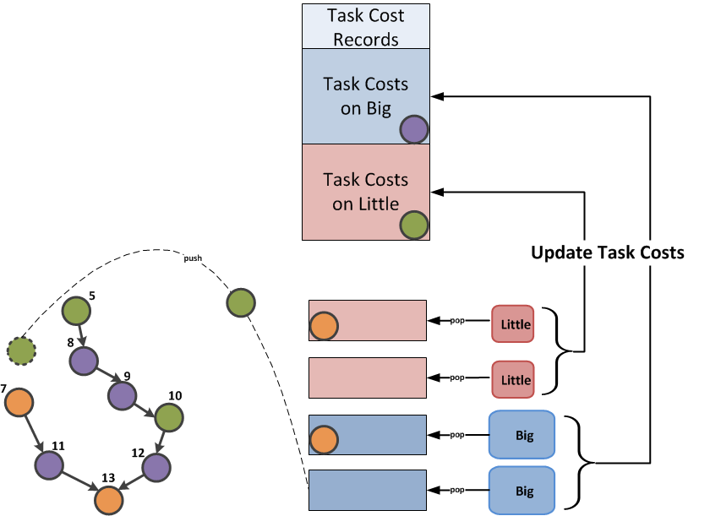
dHEFT
Back
Execute each task type/param size to each core type at least k times
Check the earliest executor of the next ready task
No priorities

Slide 33
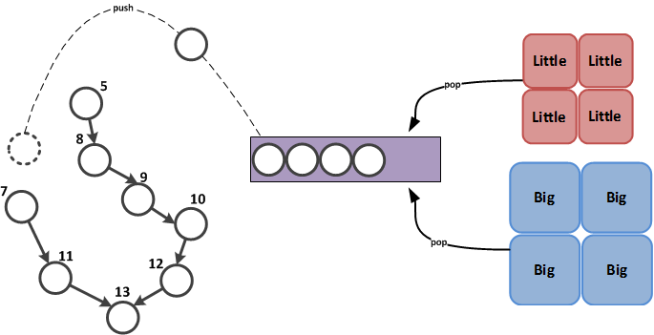
BF Scheduler

Slide 34
Ideal Speedup over little on 8 cores
Back
Measured performance ratio (M.P.R): Exec. Time on 1 Little Exec. Time on 1 Big
1 big is MPR times faster than 1 little → 1 big = MPRxlittle
Ideal Speedup over little = #little cores
#little cores = 4 little + 4 big
How many little cores is one big core?
#little cores = 4 little + 4 x MPR
Ideal speedup over little = 4 + 4 x MPR

Slide 35
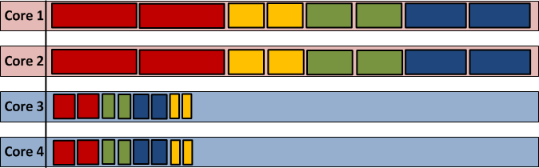
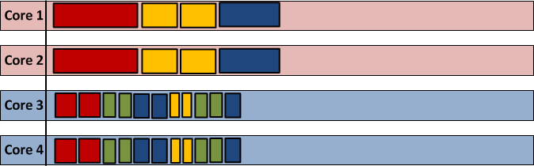
dHEFT dynamic task costs profiling
Back
1st task execution is discarded
dHEFT needs 3 samples for task cost of each task type on each cpu type
4 tasks run in each core type
Results to overhead if #little < 4
BF would schedule them more effectively using big cores as well

